Slide 1
Performance Testing
Basics 2

Slide 2
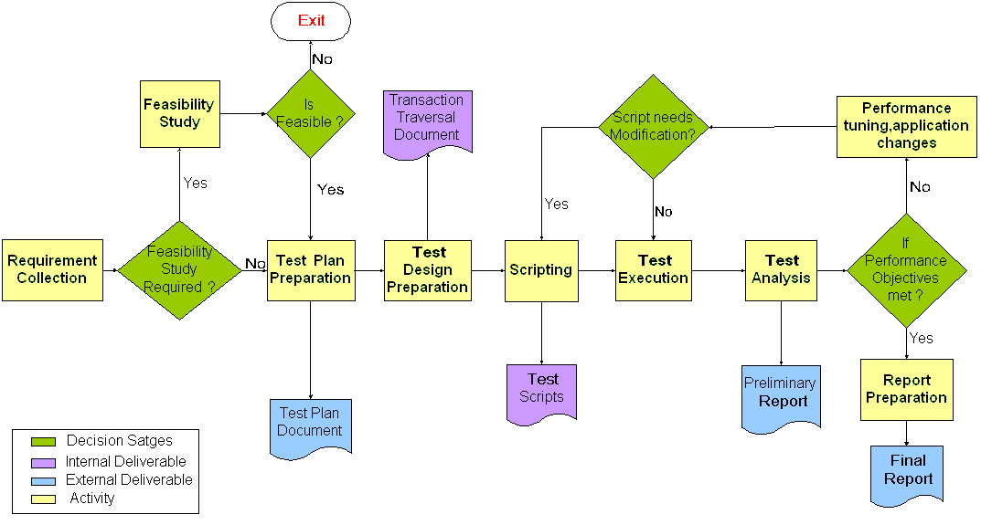
Performance Testing Process

Slide 3
Nomenclature
Application Under Test (AUT): The software application(s) being tested
System Under Test (SUT): The hardware & operating environment(s) being tested
Virtual User: Software process that simulates real user interactions with the AUT
Navigation Flow: A user function within the AUT
Scenario: A set of navigation flow defined for a set of virtual users to execute.
Think Time: Time taken by the user between page clicks
Ramp up: Gradual increase of vusers during controller execution
Throughput: It is the amount of work that a computer can do in a given time period

Slide 4
Nomenclature (Contd…)
Transaction
  A subsection of the measured workflow
  More granular user events for which response time will be measured
Bottleneck
  A load point at which the SUT/AUT suffers significant degradation
Breakpoint
  A load point at which the SUT/AUT suffers degradation to the point of malfunction
Scalability
  The relative ability or inability of the AUT/SUT to produce consistent measurements regardless of size of workload
Response Time
  The time elapsed between when a request is made and when that request is fulfilled

Slide 5
Manual vs Automated Load Testing Tool
Limitations of Manual Testing
  Expensive, requiring large amounts of both personnel and machinery
  Complicated, especially coordinating and synchronizing multiple testers
  Involves a high degree of organization, especially to record and analyze results meaningfully
  Repeatability of the manual tests is limited

Slide 6
Manual vs Automated Load Testing Tool
Purpose of using an Automated Load Test Tool
  The MAIN purpose of running automated load tests is to emulate the REAL world as close as possible while saving time and effort
Tips for selecting an Automated Testing Tool
  Ease to use (and learn)
  Standards compliance
  Robust and Reliable (accurate)
  Flexible
  Affordable
  Maintenance and Support

Slide 7
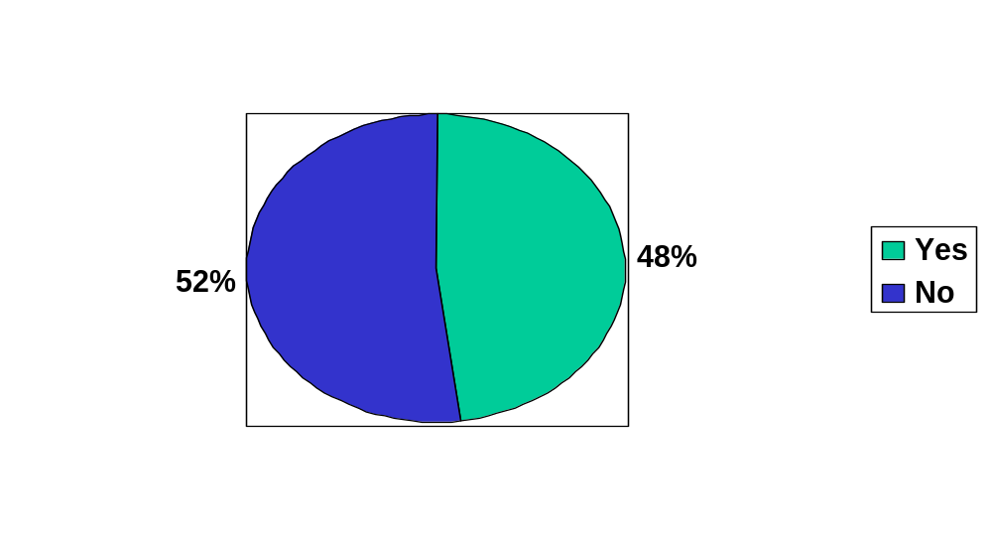
Automated Load Test Survey
Did your application scale as expected ?

Slide 8
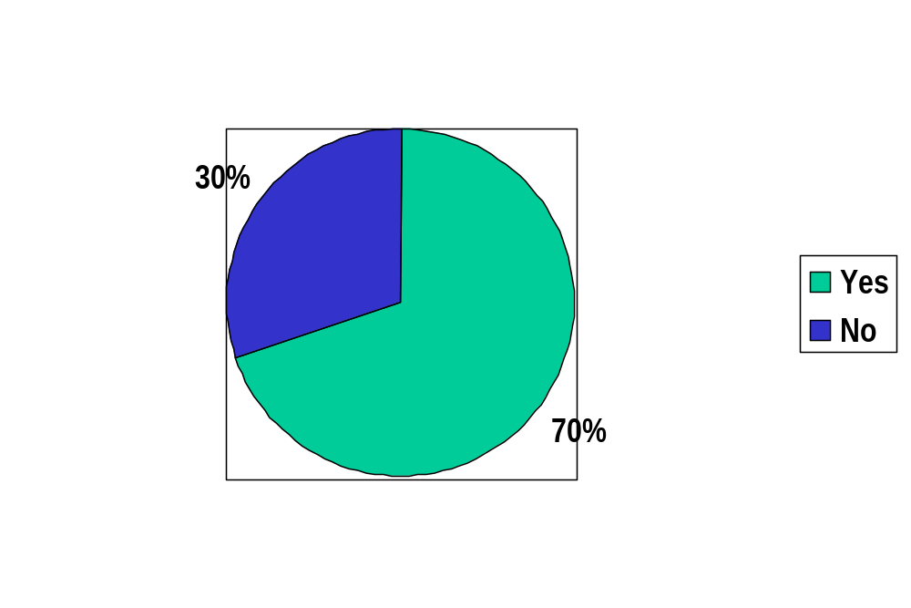
Automated Load Test Survey
From 48% - Yes
Did you use an Automated load testing tool?

Slide 9
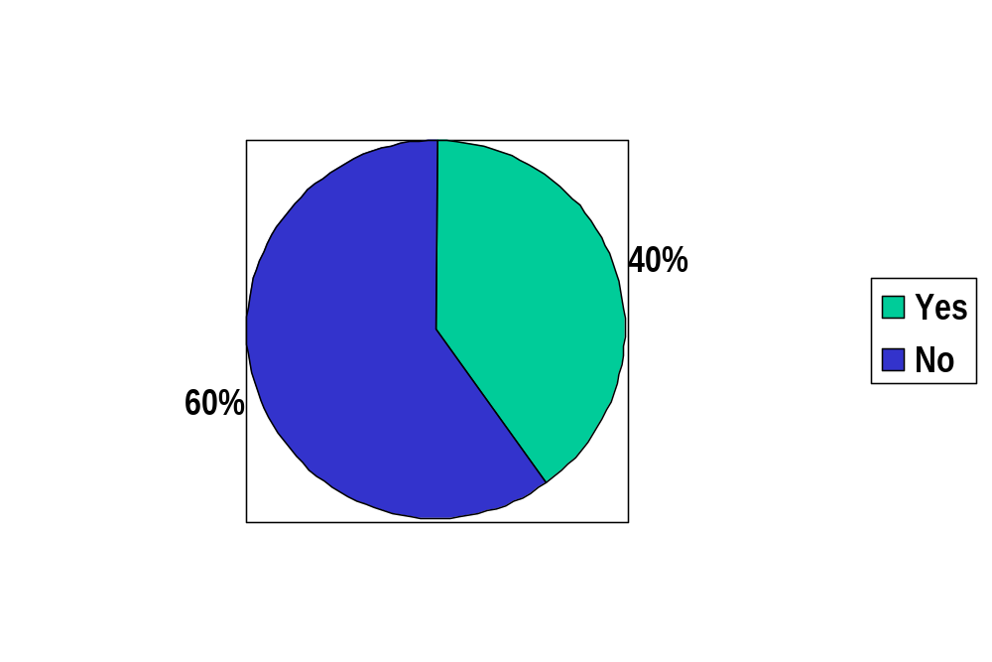
Automated Load Test Survey
From 52% - No
Did you use an Automated load testing tool?

Slide 10
How Load Test Tool Works?
Capture protocol level traffic
Use scripting language to replay that traffic
Do not interact with client system on playback
Do not actually invoke browsers on playback
Can simulate many users from many machines (IP Spoofing)
Do not evaluate correctness of returned page, just codes and sizes
If done correctly, no application tier can tell the difference

Slide 11
Execution Model
1. Over the net
  Remote execution of performance tests from offshore using remote connectivity
2. Moving Labs
  Generation of load from customer site or hosting data center
3. Replica at Lab
  Implementation of pre-production burn @ Cognizant Test Lab
Execution Models tailored to match client requirements

Slide 12
Questions & Answers
Session

Slide 13
Thank You

